Slide 1
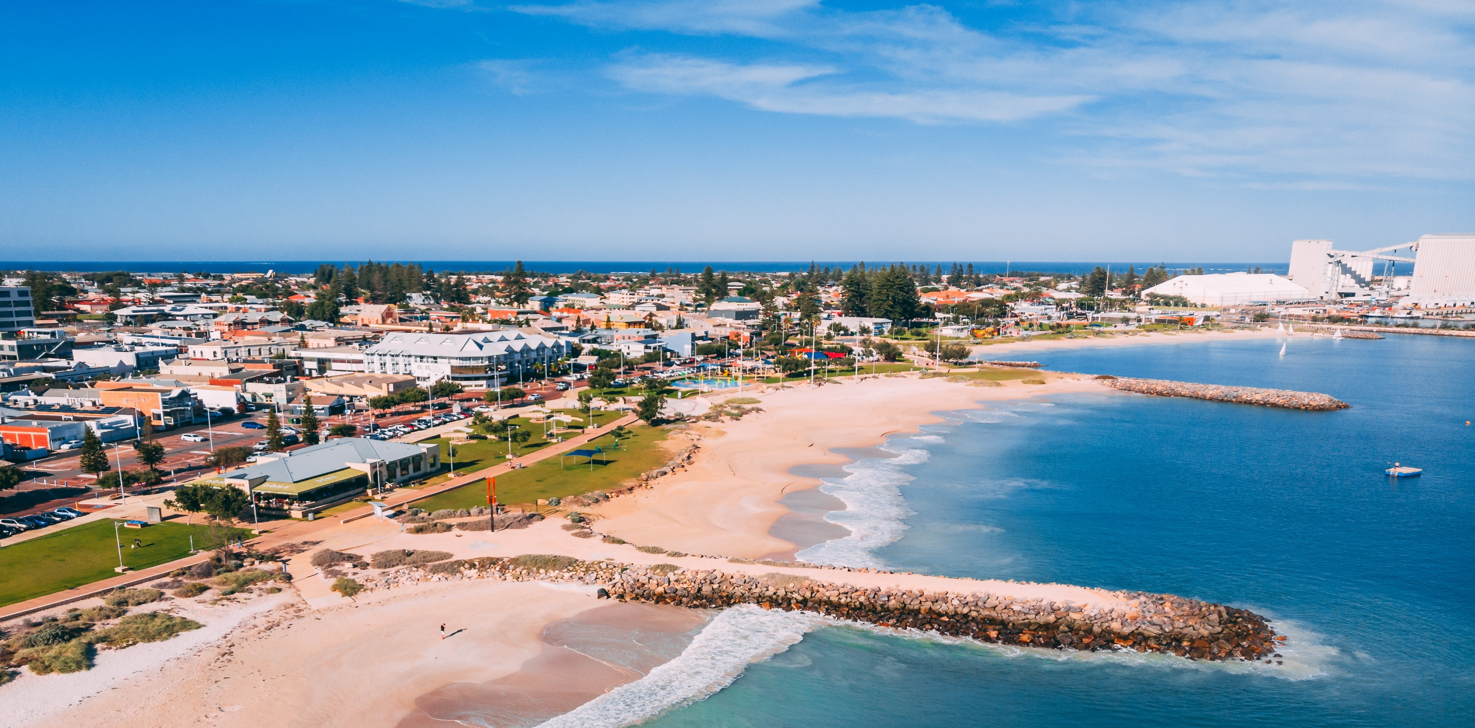
Candidate Information Session
23 August 2023

Slide 2
Presentation by: Ross McKim- CEO of City of Greater Geraldton Apologies from: Michelle Harvey – WA Electoral Commission Councillor Steve Cooper

Slide 3
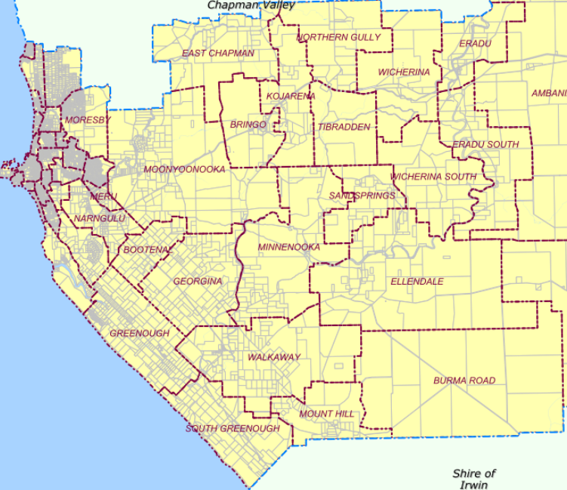
Greater Geraldton

Slide 4
What is the Local Government?
The City of Greater Geraldton is a local government constituted under the Local Government Act (1995).
It is responsible for providing key services and functions as required under legislation determined by the Parliament of the state of Western Australia.

Slide 5
What is a Local Government?
A local government is constituted of two distinct functional areas being:
The council who are democratically elected (by residents and ratepayers).
The Chief Executive Officer who is appointed by the council and is responsible for the implementation of council policy and strategy, delivery of services and day to day management.

Slide 6
Elected Council
Individual councillors, including the mayor, cannot make decisions as individuals.
The council itself does not have any delivery or executive functions, but rather relies on the decisions of the majority of the group which provide direction for the Chief Executive Officer to implement.

Slide 7
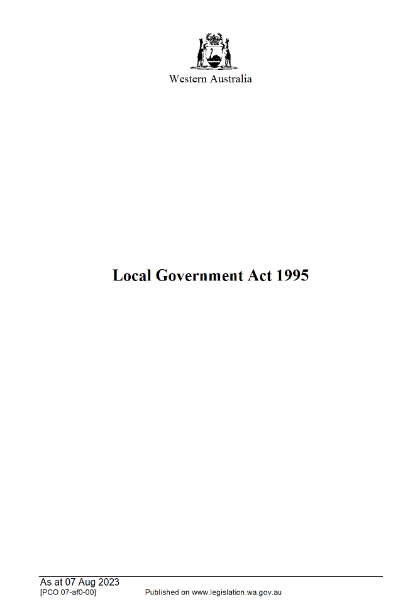
Local Government Act 1995
Section 3.1.(1):
“The general function of a local government is to provide for the good government of persons in its district.”

Slide 8
What does that all mean?
Focus must be Strategic – needs of CURRENT and FUTURE generations.
1
Focus must be Balanced - Society, Environment, Economy
2
Focus needs to ensure robust Governance is in place
3

Slide 9
Greater Geraldton 2031 Strategic Community Plan
The Greater Geraldton 2031 Strategic Community Plan is legislatively required as part of the Integrated Planning and Reporting Framework under the Local Government Act 1995 for the purposes of:
Ensuring the community is involved in the setting of a long-term vision;
Providing Council with a clear understanding of the community’s well-being, priorities, aspirations, needs and wants; and
Guiding the priority setting within the City’s Corporate Business Plan.

Slide 10
Councillors
The role of councillors is to:
Represent the interests of electors, ratepayers and residents of the district;
Provide leadership and guidance to the community in the district;
Facilitate communication between the community and the council;
Participate in the local government’s decision making processes at council and committee meetings; and
Perform such other functions as are given to a councillor by the Local Government Act 1995 or any other written law.

Slide 11
Mayor
The role of the mayor is to:
Preside at meetings in accordance with the Local Government Act 1995 (and Meeting Procedures Local Law);
Provide leadership and guidance to the community in the district;
Carry out civic and ceremonial duties on behalf of the local government;
Speak on behalf of the local government;
Perform such other functions as are given to the mayor by the Local Government Act 1995 or any other written law; and
Liaise with the CEO on the local government’s affairs and the performance of its functions.

Slide 12
Local Government Responsibilities:
Roads, Drainage and Park, Sporting and Community infrastructure construction and maintenance.
Ranger Services – Dogs, Cats, Parking.
Planning and Building Compliance.
QEII, QPT, GRAG, Youth Centre.
Environmental Health.
Waste Services.

Slide 13
NOT Local Government Responsibilities:
Hospitals.
Main Roads.
Water and Sewerage Services.
Communications (Telephone, WiFi etc).
Police.
Public Housing.
Education.
The Ocean.
The Port.
Railways.
ADVOCACY

Slide 14
Typical Month in the life of a Councillor
Attend community and Council events: (Australia Day, ANZAC Day, Big Sky Festival, HMAS Sydney Memorial Service, Shore Leave, GRAG opening etc etc.
Talk to the local community (usually you will be at work or shopping), action accordingly.
Receive and read council related emails and Agendas.
LOTS OF READING
Attend and participate at Committee meetings, Concept Forum, Agenda Forum and Ordinary Meeting.

Slide 15
IF ELECTED:
You become a community figure – your contact details are made public.
You will need to be able to manage being approached by un-happy residents.
You will have reporting requirements to the State Government about your family, and your financial interests. (Conflicts of Interest) which you must declare.
Once the Council vote on a matter and the Council makes a decision, as a councillor, you need to support the decision.

Slide 16
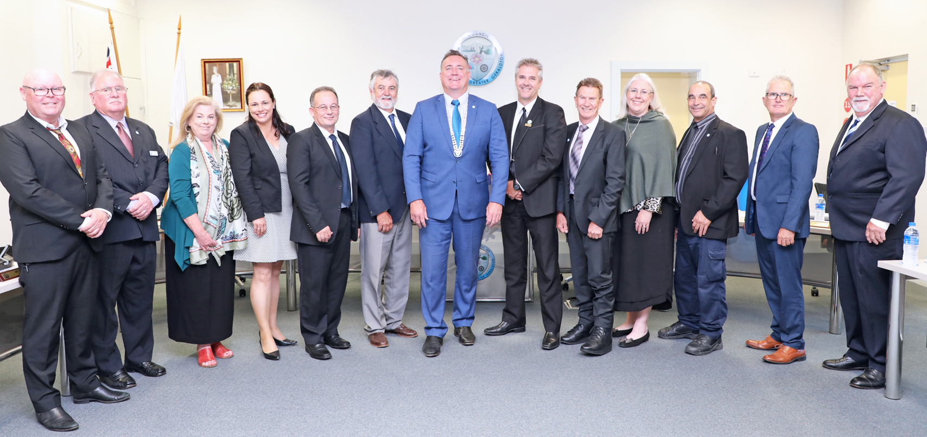
Council Meetings
Council’s meeting process is:-
1st Tuesday of the Month: Council Concept Forum
Tuesday before the
Ordinary Meeting of Council: Council Agenda Forum
Last Tuesday of the Month: Council Meeting

Slide 17
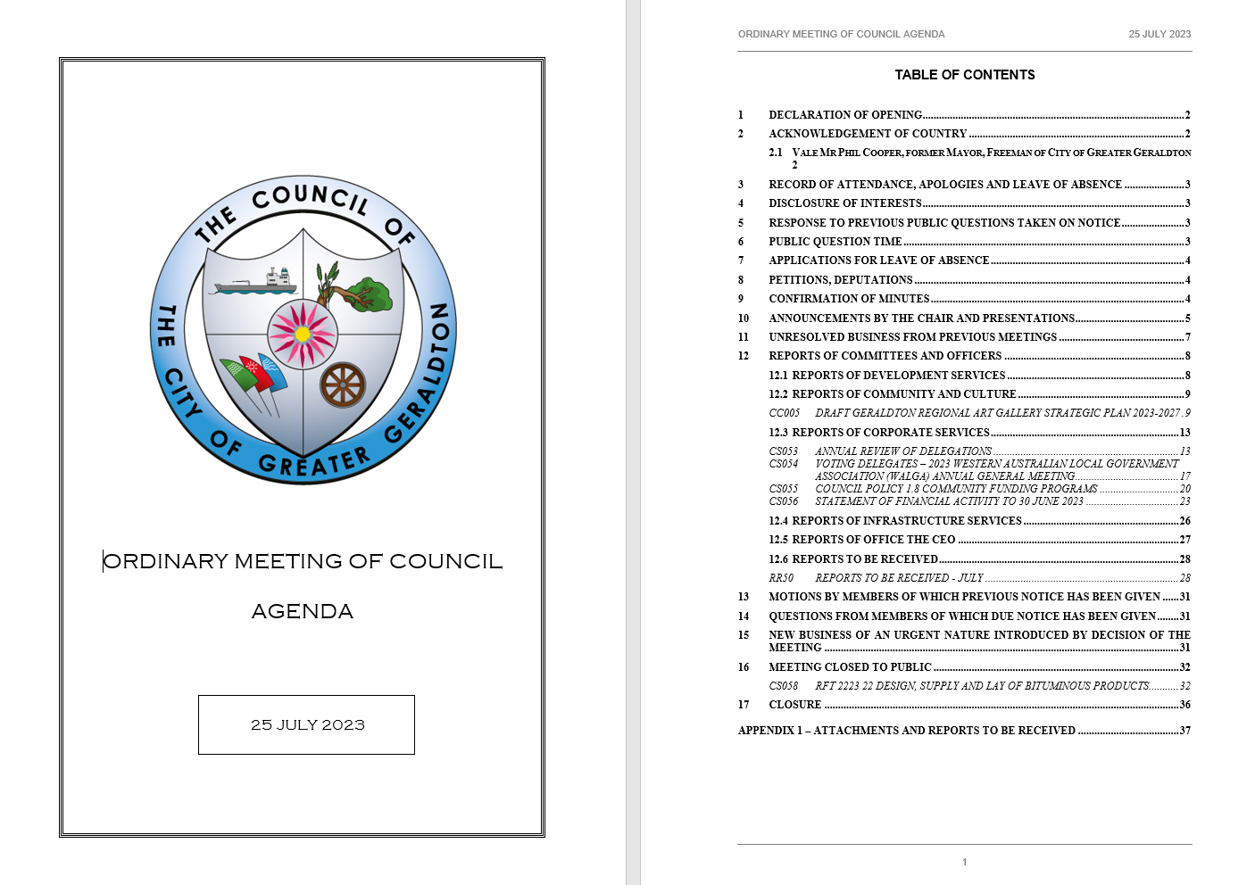

Slide 18
Meetings are livestreamed and recorded

Slide 19
Key Infrastructure Projects

Slide 20
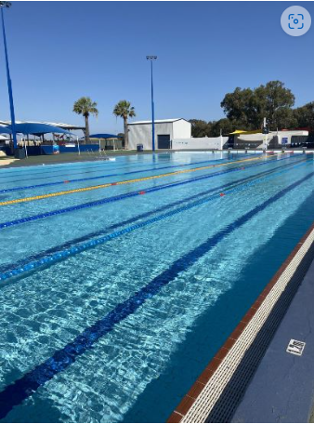
Aquarena Outdoor Pool
The outdoor pool upgrade is being undertaken by Cooper & Oxley, a commercial construction company experienced in the specialised field of aquatic facility construction and refurbishment. They have engaged Commercial Aquatics Australia, one of the largest and most experienced specialist aquatic facility contractors in Australia, as their project partners.
The $6.1 million project is joint funded with the State Government’s Community Sporting and Recreation Facilities Fund contributing $750,000 towards the works.
The estimated date of completion of works is September 2023

Slide 21
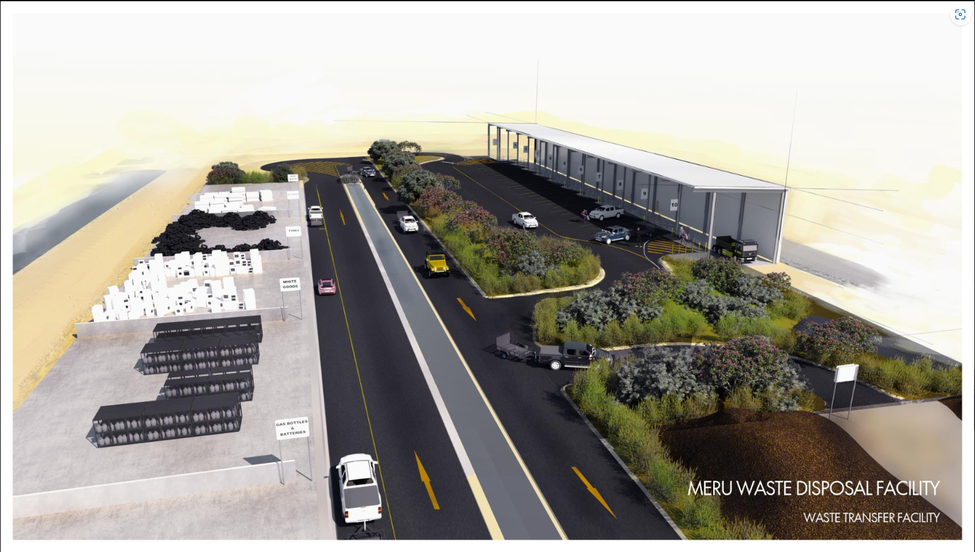
Meru Waste Facility Transfer Station
Construction of the new 20 bay waste transfer station will make it easier for residents to safely separate their waste, which will reduce cross-contamination, and enable more recyclable materials than ever before to be collected and processed for reuse. Reducing waste to landfill also extends the life of the landfill disposal cell.
The $7.36 million project is joint funded with the Australian Government’s Building Better Regions Fund contributing $1.13 million and the City the remaining $6.23 million.

Slide 22
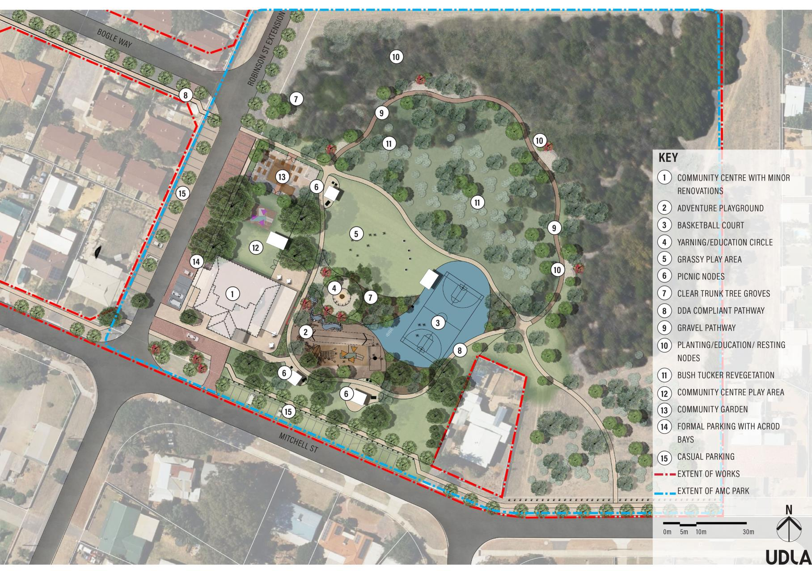
Spalding Revitalisation Project
Construction of the Spalding Revitalisation Project which includes upgrades to the Mitchell Street Community Centre, building new road extensions and upgrading the AMC Park is underway.
The $5.2 million project is joint funded with the State Government providing $4.9 million in grant funding and the City contributing the remainder towards the works.

Slide 23
Key Operational Challenge
Keeping Costs Down.
Coastal Erosion
Waste Management
New legislation:
Local Government Act Amendment
Safety Act
Dog Act Amendment

Slide 24
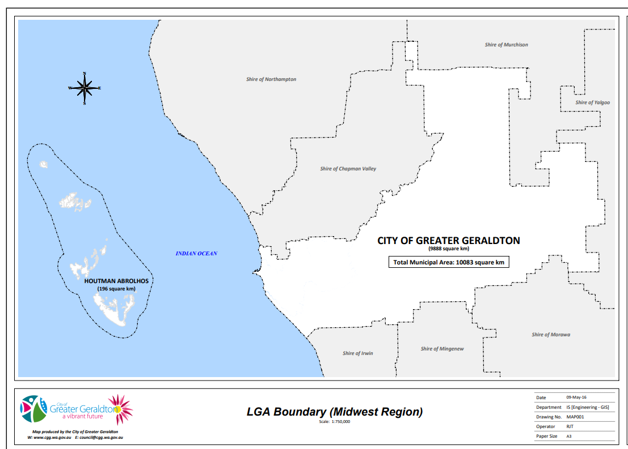
Election Vacancies
The City of Greater Geraldton District has a total of five vacancies
1 Mayor – 4-year term expiring in October 2027
4 Councillors – 4-year terms expiring in October 2027

Slide 25
Election Signage
No Election Signage on council property:
Council Policy 4.23 Elections Signs.
May be interpreted as endorsing a candidate.
The City will remove and retain signs until a payment is made to the City for retrieval as per current Fees and Charges.

Slide 26
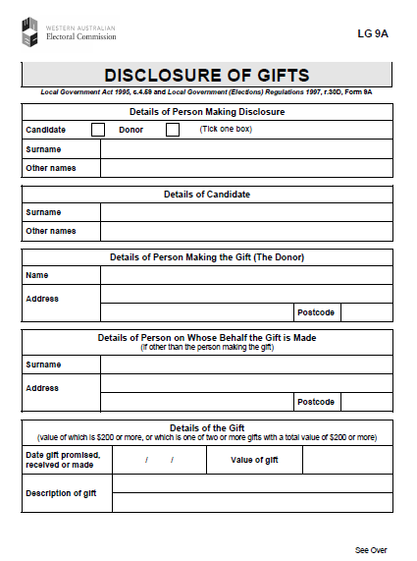
This Election – Gifts [Promised or Made]
Local Government (Elections) Regulations 1997
Must declare Gifts ASAP or penalties apply – 3 Days
Both receiver and donator have to declare the gift.
Really Important!!
Disclosure of Gift Forms (LG 9A) available on the WA Electoral Commission website
https://www.elections.wa.gov.au/sites/default/files/content/documents/LG09A-Disclosure_of_gifts.pdf

Slide 27
This Election - Behaviour
Play the issue, not the person.
01
Have a key message and get it out there.
02
Don’t promise things LG’s don’t manage or can’t deliver in case you get in.
03

Slide 28
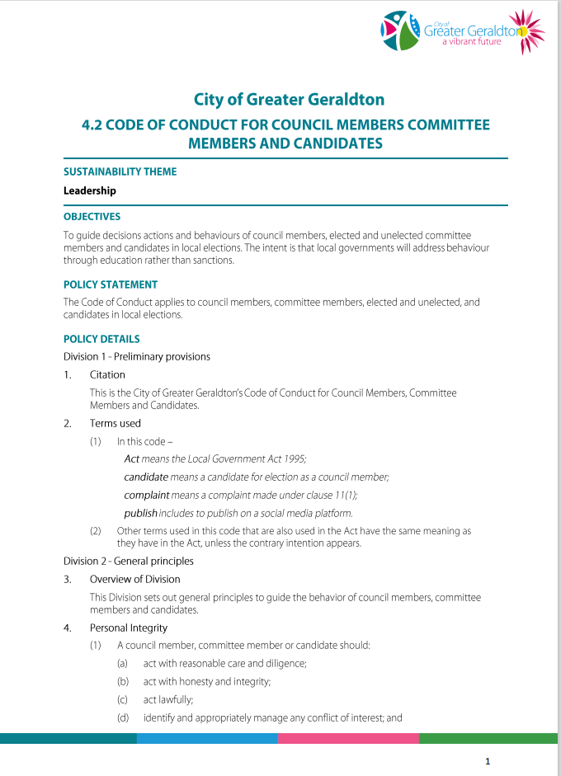
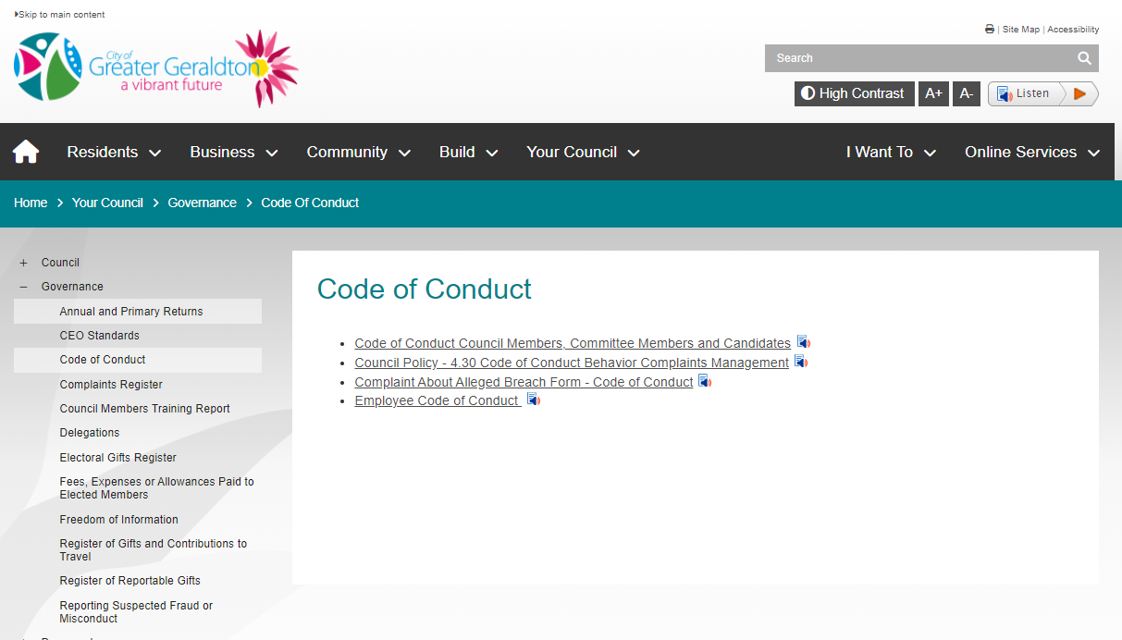
Code of Conduct for Council Members, Committee Members and Candidates

Slide 29
Thank you Any Questions ?

